Slide 1
Thank you for another excellent week Homeroom!!!!
We’re all thinking it, right????

Slide 2
Today’s Opener: The latin root word “Aud”
Write Aud at the top of the next page in your composition book
Write it’s meaning: Sound
Write 5 example words: push yourself to think of your own example words or use mine…
Audio
Audible
Audience
Audiovisual
Audition
4. Draw a picture with color to represent sound!!!
4.

Slide 3
EQ: What are scholarly habits?
Work: 1. Quiz on Kaplan’s Habits of a Scholar 2. Anticipation for unit 1: Facing Adversity. Gary Racer How Winners Are Made. What do you see, hear, feel and believe?
Closing: Friday Recognitions: 100’s so far… Great attitudes… and Friday Reflection: Think about your week in this class. Did you complete all work? How was your classroom collaboration? How do you know this Can you tell me more? What questions do you have?
Homework: I Am poem is due. Start thinking about what you know of adversity! 1st unit starts on Monday!!!!!
Standard: CCSS.ELA-Literacy.L.4.B Use common, grade-appropriate Greek or Latin affixes and roots as clues to the meaning of a word or phrase

Slide 4
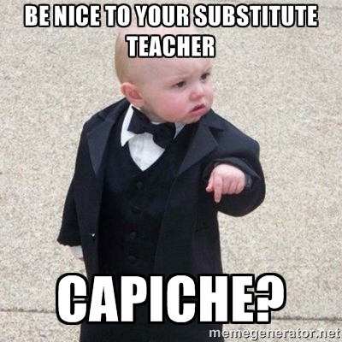
Sub on Monday…
You will have a reading packet on Inference to work on. Use the sheet and annotate each passage using the metacognitive markers.
Not sure if you’ll have a sub or be split
3.If I receive any negative reports, there will be consequences

