Slide 1
Wishing each of you an awesome Thursday!!!

Slide 2
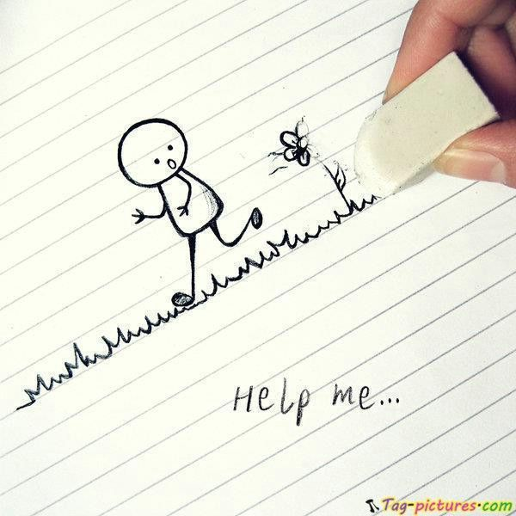
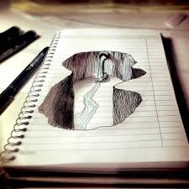
Today’s opener: Choose one of the line images and complete the drawing
Here’s some creative examples!!! But use the lines on your paper to begin…

Slide 3
Work Session:
Quiz on Classroom Procedures
2. M & M conversation starters

Slide 4
You will work with a partner. Open your bag of M&Ms. Sort them by color. Take turns asking the following questions to each other.
Do you have a pet? Eat all the brown M&Ms if you both have a pet.
What is your favorite food? Eat all the red M&Ms if you both like the same food.
What is your favorite Olympic sport? Eat all the blue M&Ms if you like the same sport.
What is your favorite song? Eat all the yellow M&Ms if you like the same song.
Where would you take your dream vacation? Eat all the green M&Ms if you like the same vacay.
What is your favorite color? Eat all the orange M&Ms if you like the same color.
How did you do? Do you have a lot of M&Ms left? Eat them together and agree to disagree!!!

Slide 5
ELT Quiz Review!!!!! Yes, you’re taking an agenda quiz tomorrow
Find the following answers in your agenda…
Homeroom begins at what time?
Is having a locker guaranteed, or a priviledge?
If you need to ride on another bus, what do you need to do?

