Slide 1
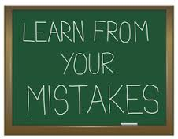
Welcome!!!
Take a seat and find your quiz corrections. Place them in the middle of your quad.
Quiz corrections were optional…

Slide 2
How are you pacing yourself for the Tic Tac Tale Project???
Project Due Date Friday 10/28/16
Some examples of previous work…

Slide 3
Blocking Scenes…
How do you do it???
Two Types of Characterization:
Direct-the author tells us about a character’s personality
Indirect-we have to read closely to understand a character’s personality

Slide 4
Sacred Last Two Minutes…
Carefully pack up your papers
Sit quietly and wait to be dismissed!

