Slide 1
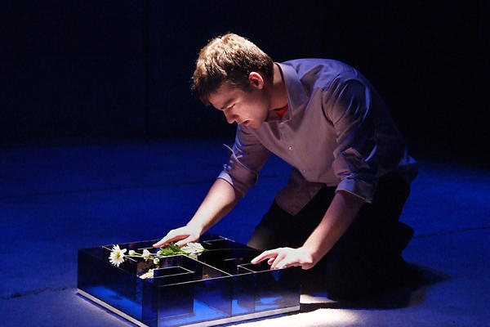
Today’s warmup: Think about what you know so far about Charlie Gordon. Is Charlie flat or round? Static or Dynamic? Is the characterization direct or indirect?
Does he have a foil?

Slide 2
After you finish the quiz…please remain quiet and read Flowers for Algernon.

Slide 3
What changes become apparent in Charlie immediately following the operation?
Explain the changes in Charlie’s attitude toward Algernon and how Charlie feels about the way Algernon is being treated.
Miss Kinnian cries when Charlie tells her that everyone is good. Why?
**Stamp sheet to track your participation. Minimum of 8 stamps = perfect classwork grade for the week. 1st, 2nd, 3rd highest # of stamps wins a prize. You must be respectful to be called on.

