Slide 1
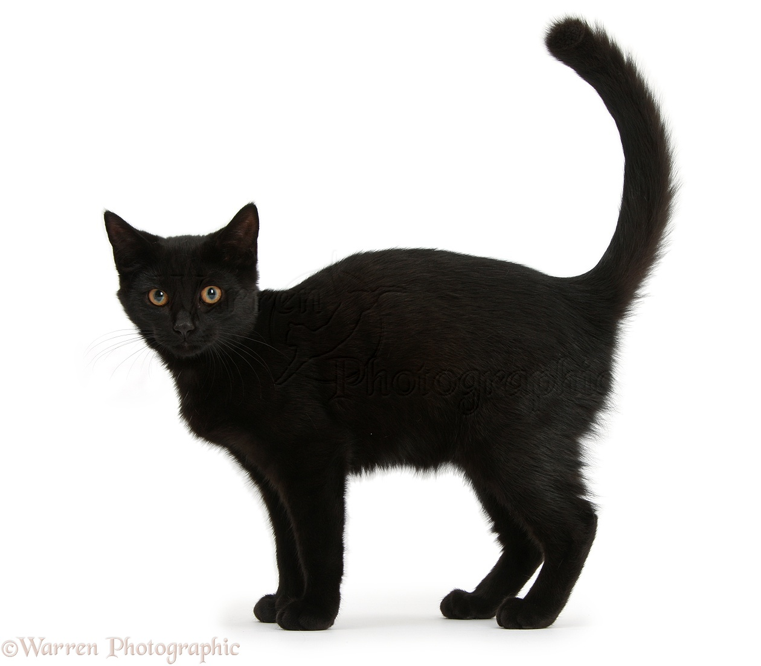
Happy Friday the 13th!!!
For today’s opener, please do three things…
Turn in Goal Setting Project folder to the 7th period basket on the back table.
Write your name on the slip of paper and place it in the basket on the back table
Clear your desk for a quick Unit 3 pre-test.

Slide 2
On Tuesday, 7th grade is taking the 2nd School-Wide writing Assessment
What will it look like???
2 reading passages
Questions for deeper thinking/analysis follow each passage
Extended Writing Prompt that asks you to compare or contrast both passages
Make a PPARR bookmark!!! Use RACES strategy!!!

Slide 3
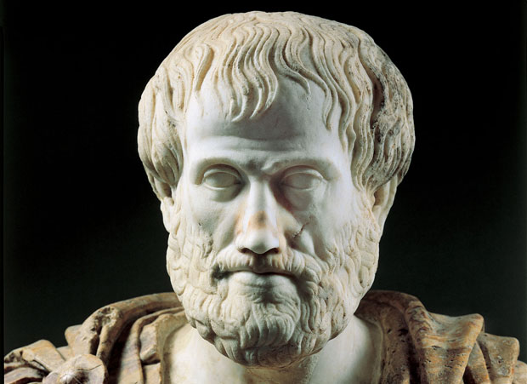
Ethos, Logos and Pathos
It all started with this guy!!!!

Slide 4

Luck of the Draw: Student name(s) are drawn from a basket to be the summarizers of the day’s information.

