Slide 1
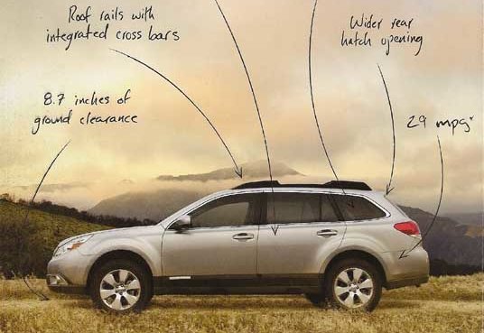
Welcome AC! Today’s opener: Which appeal is most obvious?

Slide 2
Quiz
1. Jerry McCready, an American independent candidate said, “As a self-employed businessman, I have learned firsthand what it is like to try to make ends meet in an unstable economy being manipulated by out-of-touch politicians.”
2. Senator Kennedy argued, “in Georgia, blacks who killed whites received the death penalty 16.7 percent of the time, while whites who killed blacks received the death penalty only 4.2 percent of the time.
3.Think of political commercials in which candidates are depicted petting stray dogs and reading to their kids.

Slide 3
Brain Break https://www.youtube.com/watch?v=OoHdwUEfBts
Guide to Making a New Friend

Slide 4
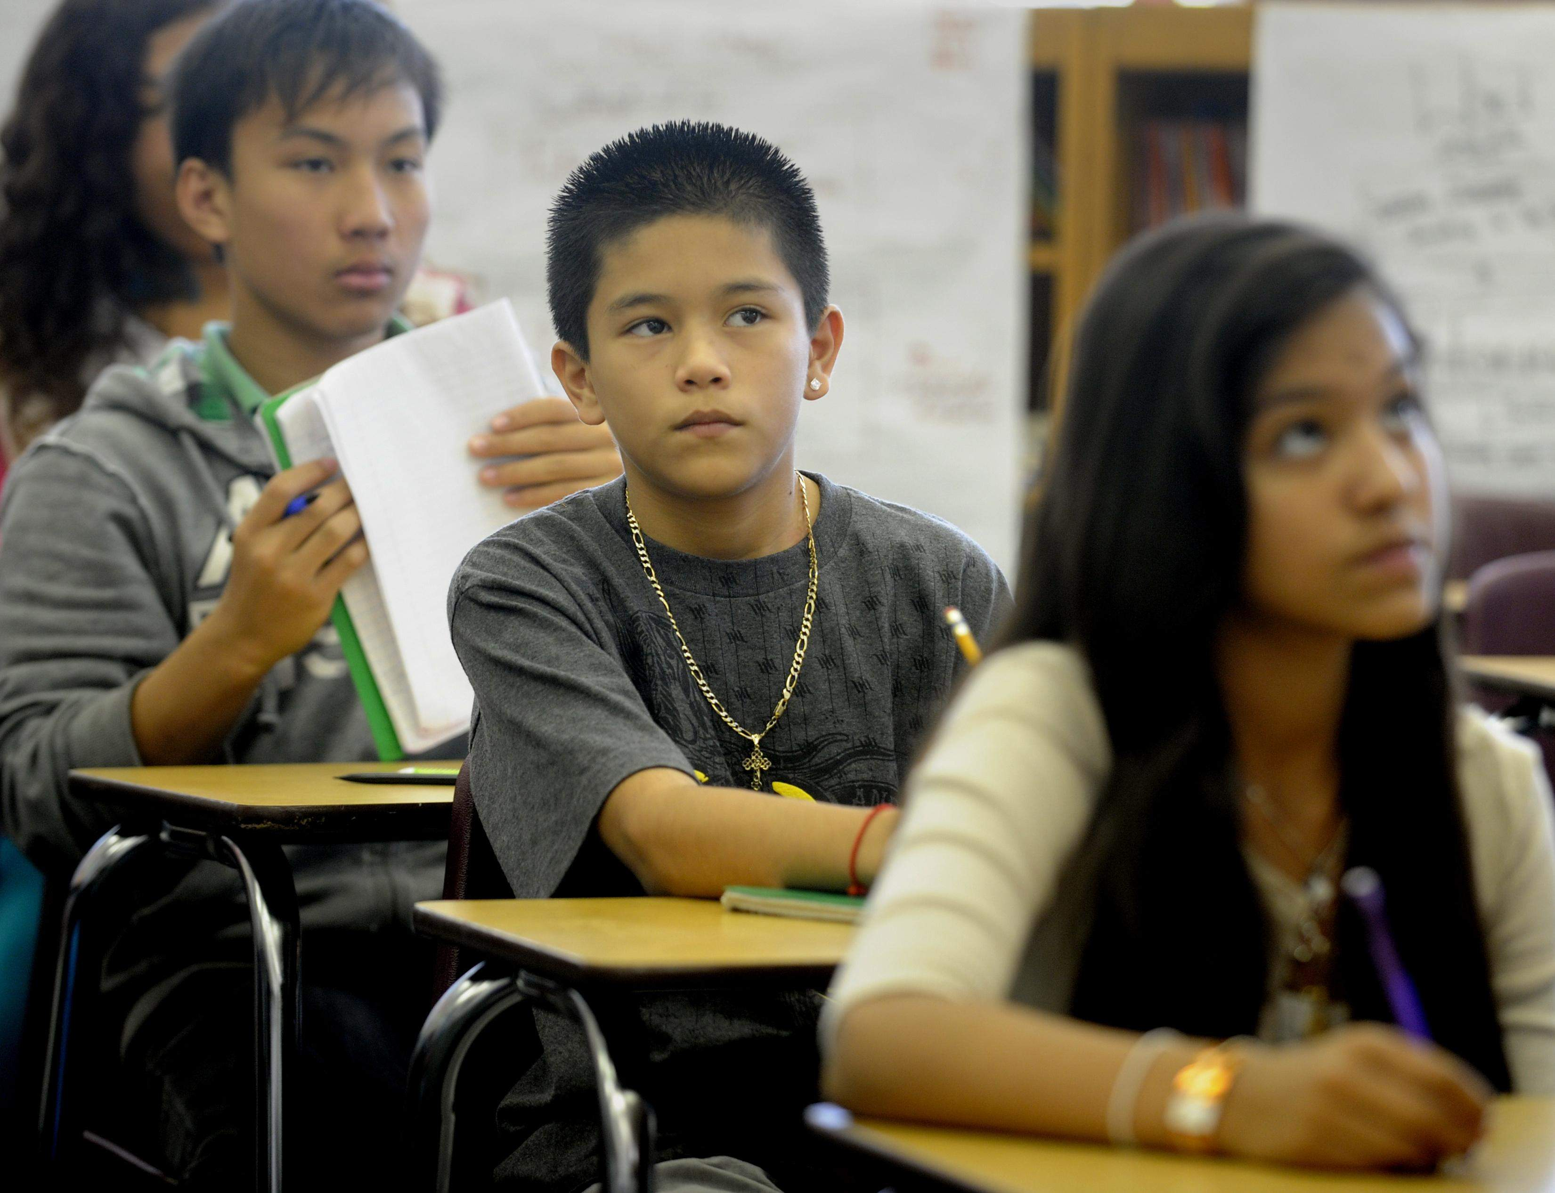
Let’s talk about giving the speeches and being a great audience!!!

