Slide 1
Welcome Fabulous AC!!
To warm up—please take out you’re a Picture is Worth a Thousand Words anecdote sheet and work on finishing all four. These are due tomorrow at the start of class—I’ll be checking them for a grade tomorrow!
Try drawing a picture with your words!

Slide 2
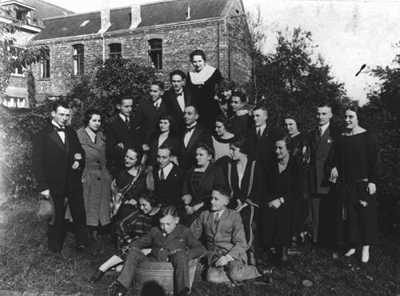
Take a minute to look at the faces. Imagine that you are the photographer taking this picture. What do you hear?
Two German Jewish families at a gathering before the war. Only two people in this group survived the Holocaust. Germany, 1928.

Slide 3
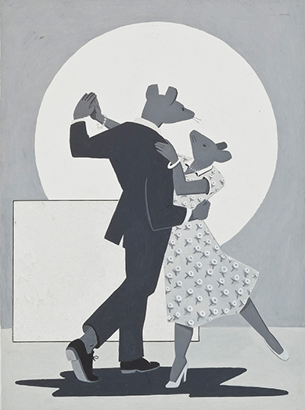
Work:
Re-enter Benchmark scantron into iRespond-Thank you Madelyn!
Chapter 2 of Maus: The Honeymoon
https://www.youtube.com/watch?v=Fi6aSsGxMes
Partner work on Chapter 2 questions
Closing:
Luck of the Draw Summarizer

