Slide 1
Welcome!!! Hope your day has been going well!!
For your opener, please take a seat quietly and begin making corrections using the proofreader’s marks on the paragraph provided.

Slide 2
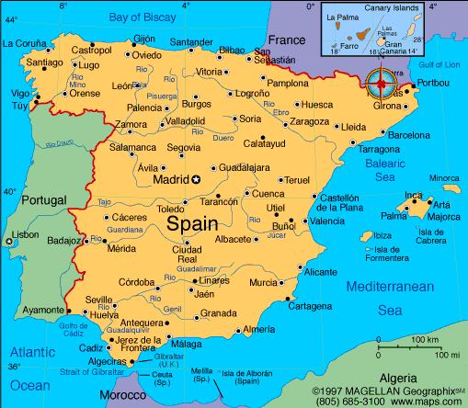

Slide 3
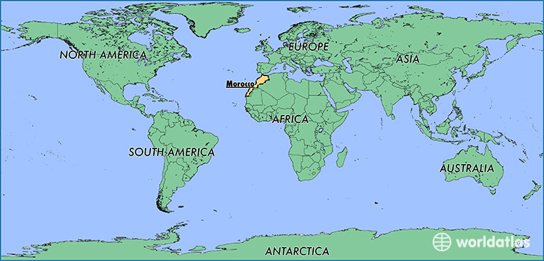

Slide 5
https://www.youtube.com/watch?v=ZzeMS8usESo
Brain Break brought to you by Ronaldo (his top ten goals)

Slide 6
Welcome Everyone!!!
Please take a seat and quietly begin your opener—Grammar into the Day. You need to find ten mistakes and mark them with the proofreader’s marks on the page.
Don’t worry! You’ll soon be a pro at using the proofreader’s marks!

