Slide 1
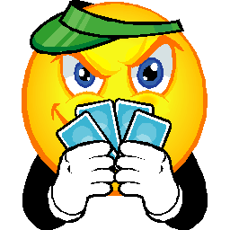
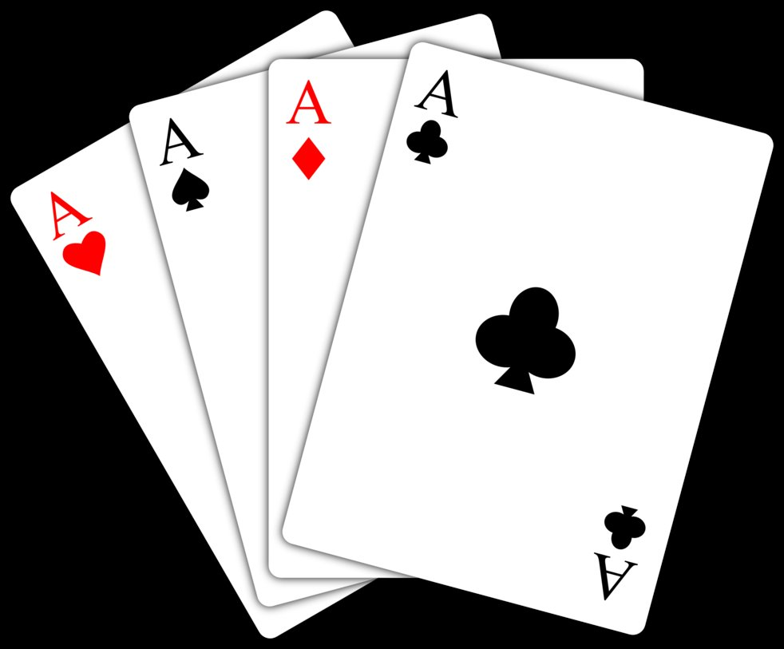
Welcome Everyone!!!
Today’s Opener is to write a response to the Principle of Favorability.
“When you play cards the first time, you are almost sure to win. Beginner’s luck… There is a force that wants you to realize your Personal Legend; it whets your appetite with a taste of success.”
Do you agree with the old man? Why or why not?

Slide 2
Work Session:
Introduce homework assignment for the week.
Partner Work: Three symbols so far… The ruined old church, 3 gold coins and Santiago’s book. Finish (finally) the active reading chart by choosing a symbol and finding the quote which tells about it. Collect.

Slide 3
https://www.youtube.com/watch?v=DljEkH3ibj8
Brain Break!!!!!!!!!

