Slide 1
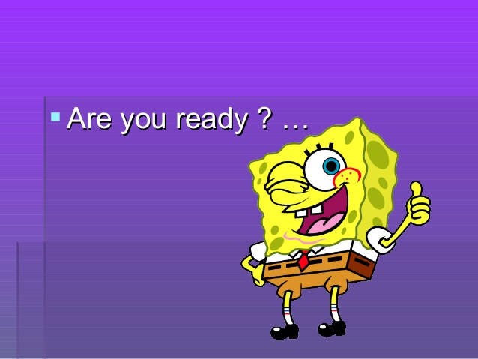
Welcome Everyone!!
Please quietly enter the room, take your seat and get started on the opener!!!!

Slide 2
Symbols
Santiago's Book - Represents the life of the intellect verses the life of learning through experiences.
Gold Coins - Santiago's father contributed gold (material beauty) to the seeking of his real treasure—his destiny.
Ruined Old Church - This represents religion and faith. It still provides sanctuary and harbors hidden treasure, even though it is out of use.

Slide 3
Work: Listen to audio version beginning on page 23. Students will begin Active reading chart #2; choose quote and strategy.
Closing: Q and A about homework assignment and summarize reading. Best summary team wins a prize.

Slide 4
The Alchemist
https://www.youtube.com/watch?v=VW-QA4UQedg

Slide 5
https://www.youtube.com/watch?v=3N022pt0lTk&list=PLS6iL38ozA1bEIspK__Up3DurQoEWhImz
Brain Break! Very Tricky—involves blinking and snapping fingers!!!!

