Slide 1
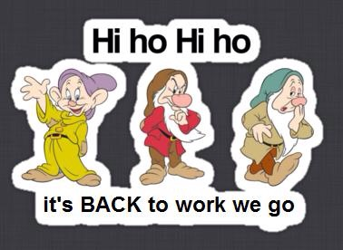
Welcome Everyone!!
Please find your new seat and then begin the Opener on the backside of the seating chart!!!! 5 mins!!!!

Slide 2
Work Session:
Re-set of class routines and expectations. Let’s focus on the following problem areas:
1. Entering the classroom and beginning the opener. Late? What to do…
What to do if you really want to say something or get up out of seat?
How do you show good manners when papers are passed out?
Why wait to be dismissed from class?
Total: 10 mins

Slide 3
A quick word about grades:
Grades have been restored and updated—please check!
Classwork grade every day this week. Two purposes:
Let’s us know how we are doing in the quad seating and collaboration work.
Gives a nice baseline of info to parents during conference week.

Slide 4
*When you are done with the pre-assessment, please move it to the corner of your desk and complete the remaining portions of your classwork and closing.
*I’ll be collecting the classwork sheet as you exit today.

