Slide 1
Good Morning Homeroom!!!!
Please do not wander around the room or move the location of desks. You may sit next to a friend until it gets close to announcements and pledge.
Thanks so much! Too much spilling when you move about the room!!!

Slide 2
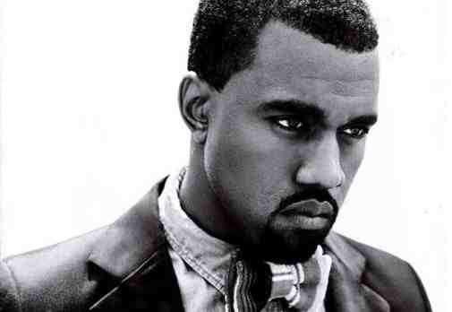
Welcome! Please take out your personal essay/anchor activity (if you didn’t turn it in yesterday)
Opener: Make some predictions—Why this song? How does this song relate to the new unit?

Slide 3
Work Session:
Unpack the standards
Close reading using Silent Exchange
Close reading using trouble slips.
Four types of rhyme
Closing: Assign Daya Homework due this Friday, October 7th

Slide 4
Let’s listen to the song together. Please read the lyrics as you listen.
Students work in quads. Each person in the group will create an open-ended question, not questions that can be answered with a simple yes or no.
Questions should be written.
Students then pass question to next person, and there is no talking.
Students have two minutes to write a response to the question, and then the paper is passed to the next person until the rotation is complete.

Slide 5
Trouble Slips--Students will take notes of where they are having difficulty in the text as they read. Afterwards, students will share what they wrote with their peers (quads.) As a group, the students discuss and work through the difficult parts of the text.

Slide 6
Four types of rhyme:
End--the use of rhyme at the ends of lines of poetry
Slant—near rhyme; similar words, but not identical sounds
Eye—similar spelling, but different sound. lint/pint
have/grave. stone/none
Identical--rhyming words that look and sound identical

Slide 7
Homework:
Daya’s Sit Still, Look Pretty is due this Friday, October 7th

