Slide 1
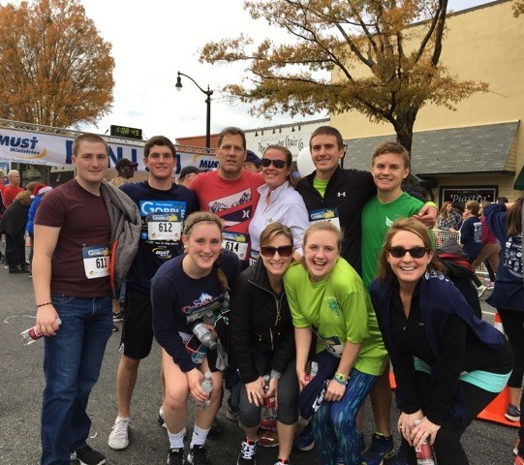
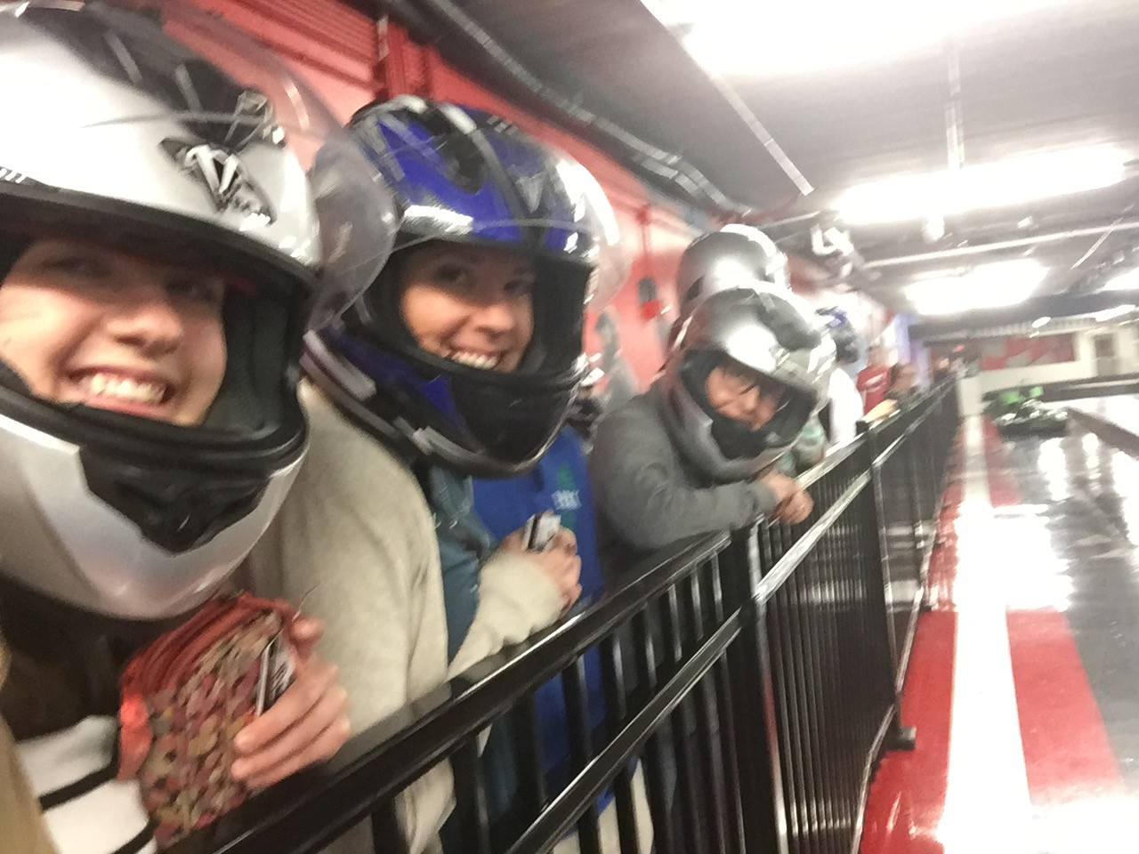
Welcome Back Homeroom!!! Hope your Turkey Break was amazing!!!

Slide 2
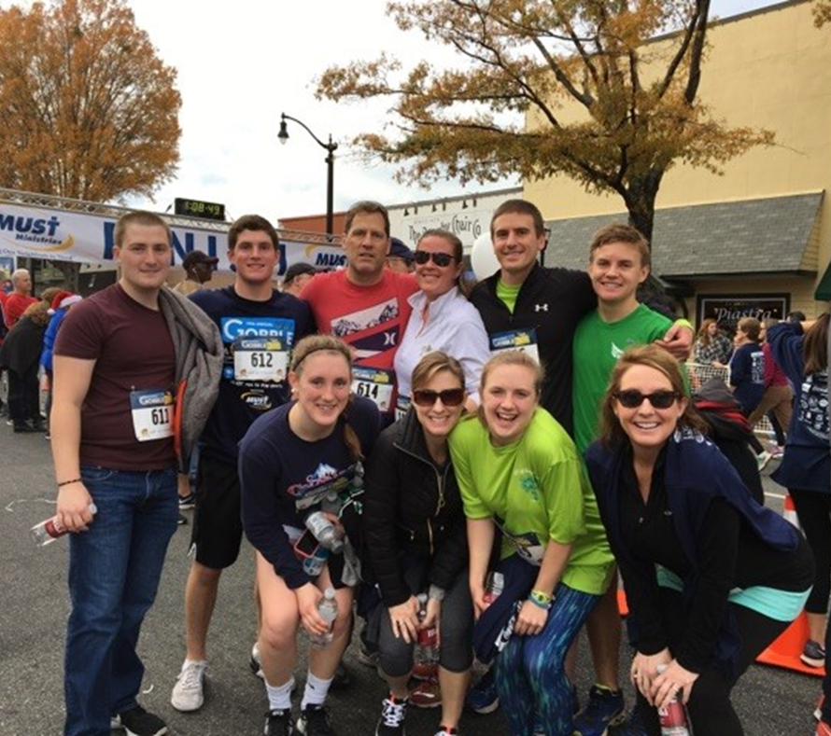
Welcome Back!!! Hope your break was amazing!
Today’s Opener is to think about what positive things this class can put in your bucket!! Take your seat quietly and begin writing…

Slide 3
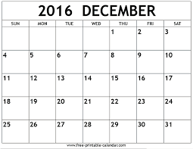
ELA
Symbols and Theme→
Finish HOMS
Chart due
Fronk Out
Quiz and project
Mini #3
Project Day
Project Day
Project Due
Cross Curricular Writing with Social Studies
Final Grades due
Last Day!!

Slide 4
AC ELA
Symbols and Theme→
Finish
FFA
WatchMovie
Fronk Out
Quiz and project
Mini #3
Project Day
Project Day
Project Due
Cross Curricular Writing with Social Studies
Final Grades due
Last Day!!

Slide 5
Brain Break:
Real Talk from Steph Curry
https://www.youtube.com/watch?v=fY1qgqhFQAw
1:00-4:14

Slide 6
http://esl-bits.net/ESL.English.Learning.Audiobooks/Mango_Street/09/default.html
Audio Book HOMS

Slide 7
http://teacherlink.ed.usu.edu/yetcres/multimedia/McDougalLiterature/g08/cd05/Flowers%20for%20Algernon%20Part%201.mp3
http://teacherlink.ed.usu.edu/yetcres/multimedia/McDougalLiterature/pages/grade08.htm
Flowers for Algernon

Slide 8
Sacred Last Two Minutes:
Packing up papers quietly and with intention.
Finishing ticket out the door
Waiting quietly to be dismissed on time.

