Slide 1
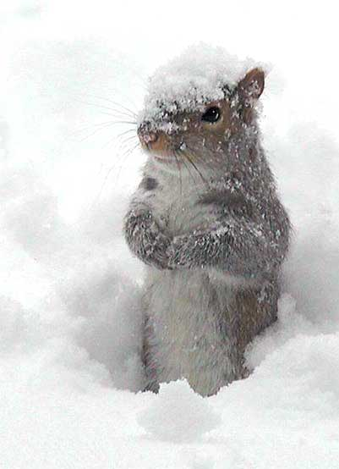
Good Morning Golden Panthers!!!
To Do List:
Visit locker! You may not keep your
backpacks in the front of the room
any longer!!!
Get breakfast!
Sit in your assigned seat and relax
with a good book or quiet conversation!

Slide 2
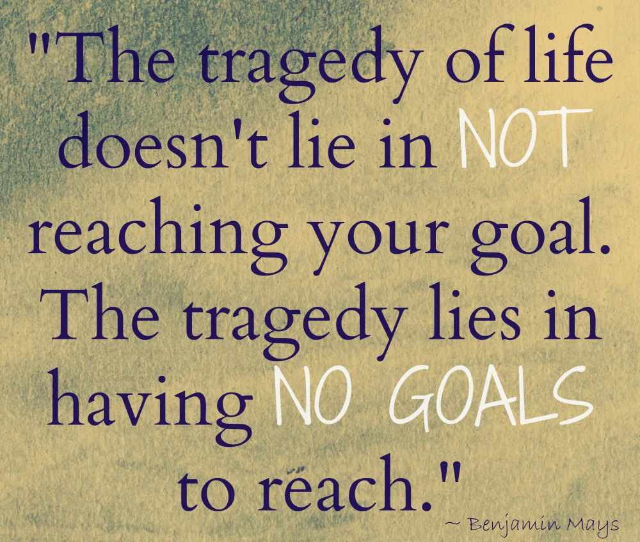
Welcome ELA!!!
Feeling a little lost and confused
after the snow days?
Don’t worry…I’ve got a plan!
Warmup by taking the
Learning Skills Inventory
Shade only the boxes you are proficient in (you do the skills well and consistently)

Slide 3
Today’s work:
Learning Skills Inventory
My Goal
17 for 2017

Slide 4
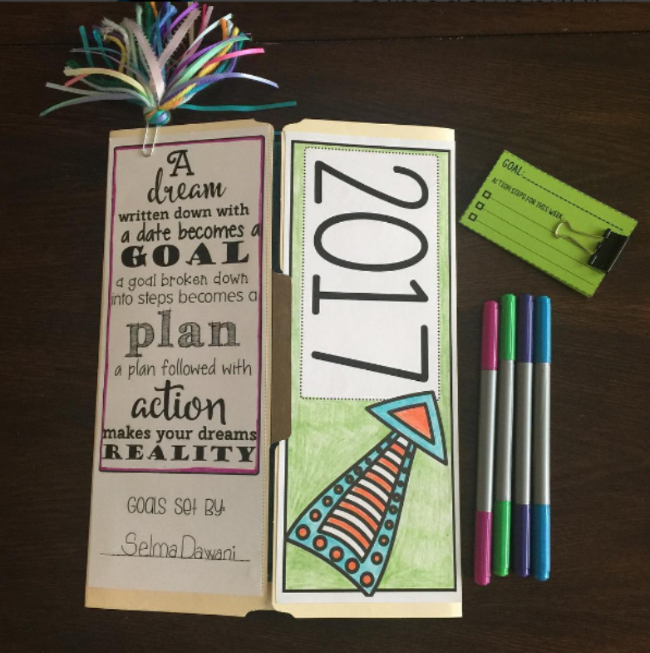
Project is due Friday, January 13th.
Let’s look at the checklist together…
You may take your folders home to complete them. Anytime the folder is done, you may turn it in to the correct basket on the back table.

Slide 5
https://www.youtube.com/watch?v=4TsmpTGr73k
Little ones can be so wise…

