Slide 1
Good Morning Golden Panthers!!!
To Do List:
Visit locker! You may not keep your
backpacks in the front of the room
any longer!!!
Get breakfast!
Sit in your assigned seat and relax
with a good book or quiet conversation!

Slide 2
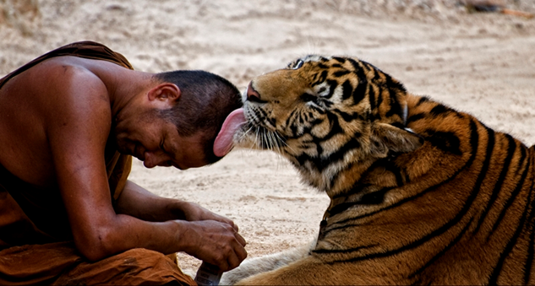
Welcome ELA!!!
Today’s Opener: Please write a caption for the picture
Have you finished your goal setting folder? Put it in the basket please!

Slide 3
https://www.youtube.com/watch?v=IwIzcNLOogc
Lean on me

Slide 4
Just a reminder, please no backbacks in our room
Please do not leave trash on the lunch table. Please sit at our table to eat—no one else’s!
Stop politely at the end of each hallway and wait for me to tell you to go on.
Please no running around and playing in the hallway during bathroom breaks!
ELT

