Slide 1
Good Morning Golden Panthers of Awesomeness!!
Let’s make it a great day!
Visit your locker
Eat a good breakfast
Take a seat and visit quietly with friends or read

Slide 2
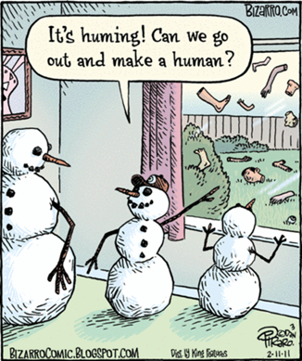
Welcome ELA!!
Hope you are having a great day!
Can you make an analogy for the comic???
__________:____________::___________:______________
Kind of gross!!!!----→

Slide 3
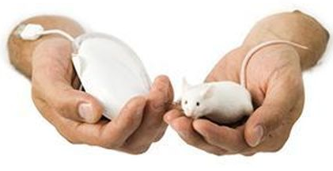
Can you make anything work as an analogy???
This is a weak analogy because its saying that just because they are both called mouses, they must be the same thing

Slide 4
Strong analogy??
What do you think?

