Slide 1
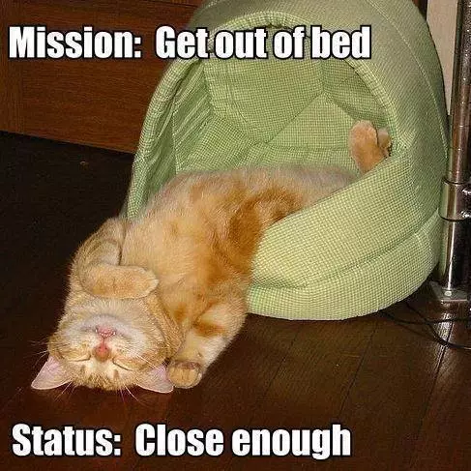
Happy Monday Morning Golden Panthers!!!
Rainy Mondays are the best!!!

Slide 2
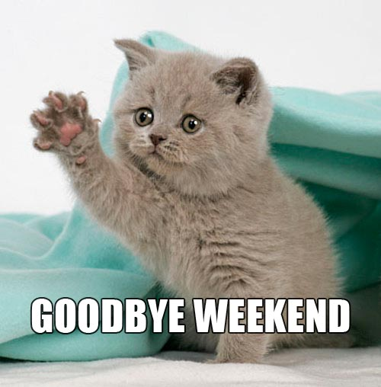
Welcome ELA!!!!
Please complete the K-W-L Chart for Poetry!!!

Slide 3
Brain Break https://www.youtube.com/watch?v=l5-EwrhsMzY Kid President Letter to a Person on Their 1st Day

Slide 4
Each acrostic poem has a topic idea running down the left side of the poem. Each letter in the topic word has a new thought that runs off the side from left to right and is relevant to the topic word. The topic word is typically the title as well.

Slide 5
Sacred Last Five Minutes…
We are quietly putting the poetry books in the basket
Take a seat and be ready for Luck of the Draw

