Slide 1
Good Morning Golden Panthers!!!!
Stay Golden in the hallways!!!
Be Nice!!!

Slide 2
Welcome ELA!!!
Today’s opener: Do you think people are scared or uncomfortable reading poetry?
Why or why not?

Slide 3
Work: 1. You will read and analyze examples of synonym and
Diamante poems. 2. Students will write a synonym and diamante poem for their poetry book. Students may illustrate poems.
Brain Break https://www.youtube.com/watch?v=OoHdwUEfBts
Kid President’s Guide to Making a New Friend
Closing: Luck of the Draw

Slide 4
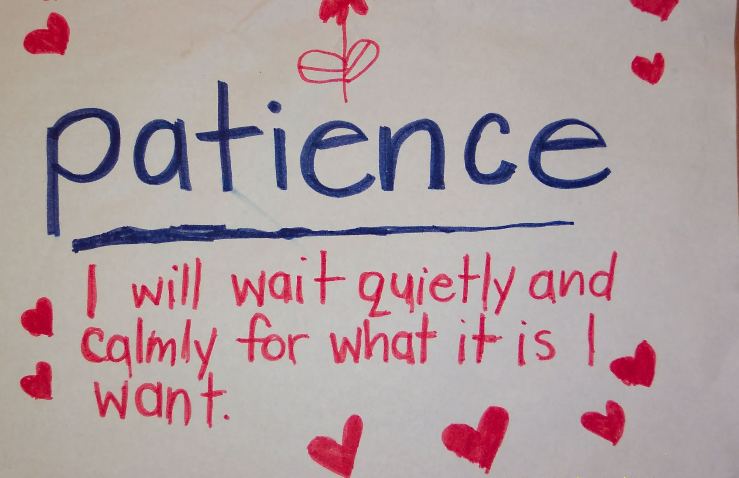
Sacred last two minutes:
Luck of the Draw and we are quiet and waiting to be dismissed.

