Slide 1
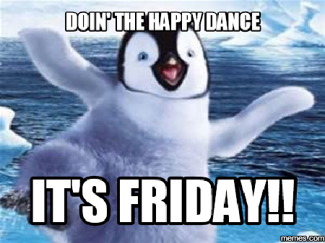
Good Morning Golden Panthers!!
Please visit your locker and eat a good breakfast!!

Slide 2
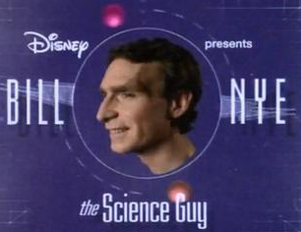
Welcome Golden Panthers!
Its Bill Nye Friday!
Bill! Bill! Bill! Bill!

Slide 3
The Golden Panther Pledge
We will be honorable to our fellow students and teachers. We will obey the rules with dignity and pride. We will be a true Golden Panther by not betraying each other.

Slide 4
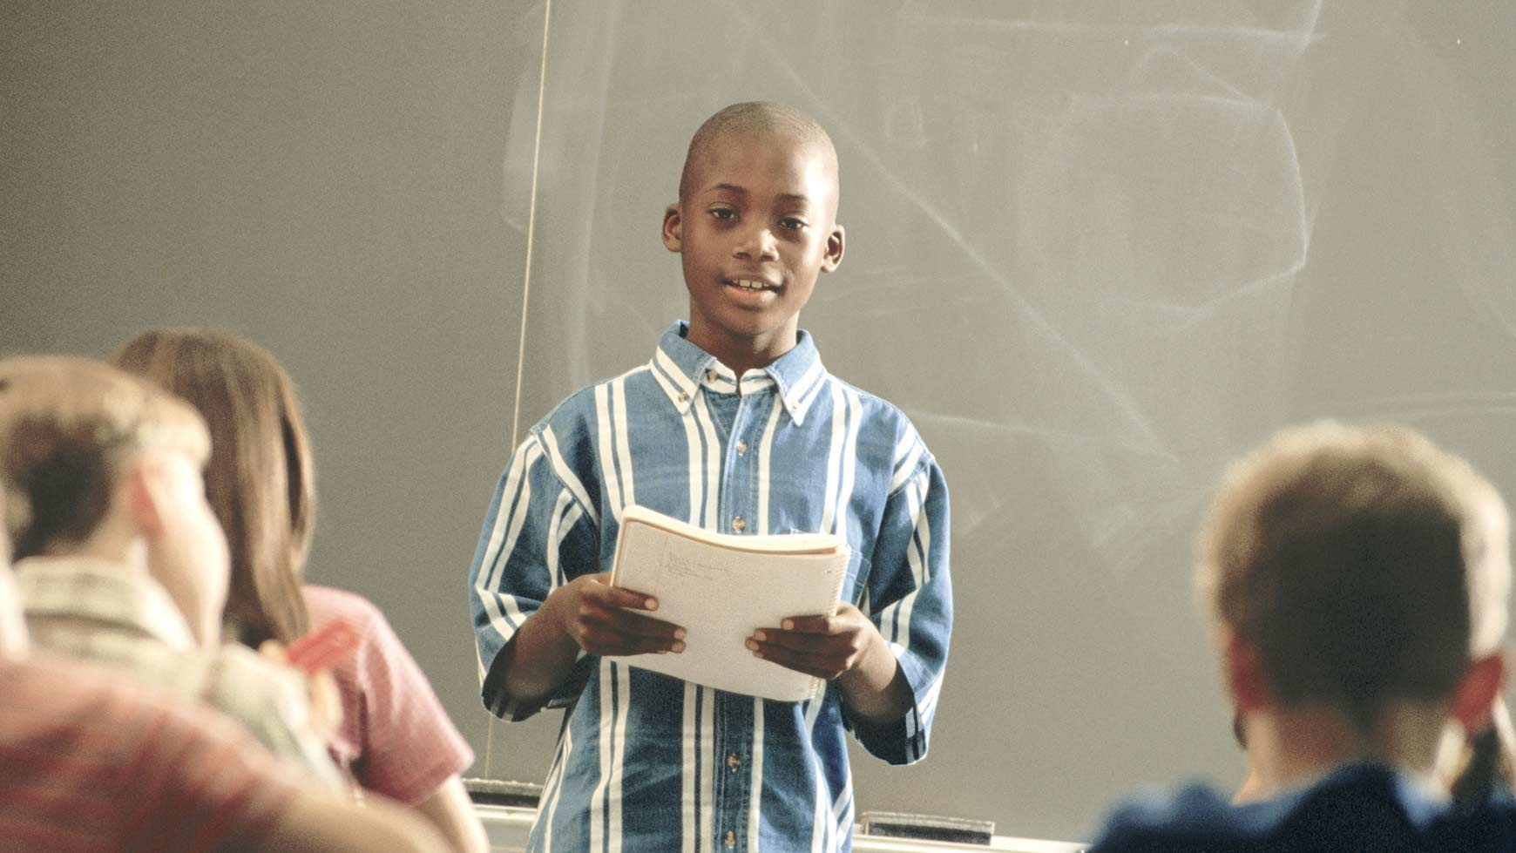
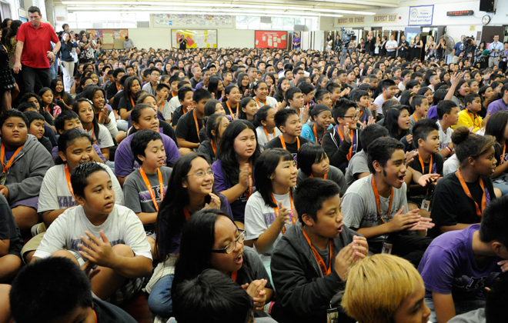
Welcome ELA!!
Please take a seat and get started on today’s warmup:
What are the important things to do when speaking in front of an audience? What is the most important thing to do when you are part of an audience?

Slide 5
Three grades into Synergy this weekend:
Partner quiz on analogies
Poetry Book check (collecting today!)
Speaking and listening grade for today’s poetry share

