Slide 1
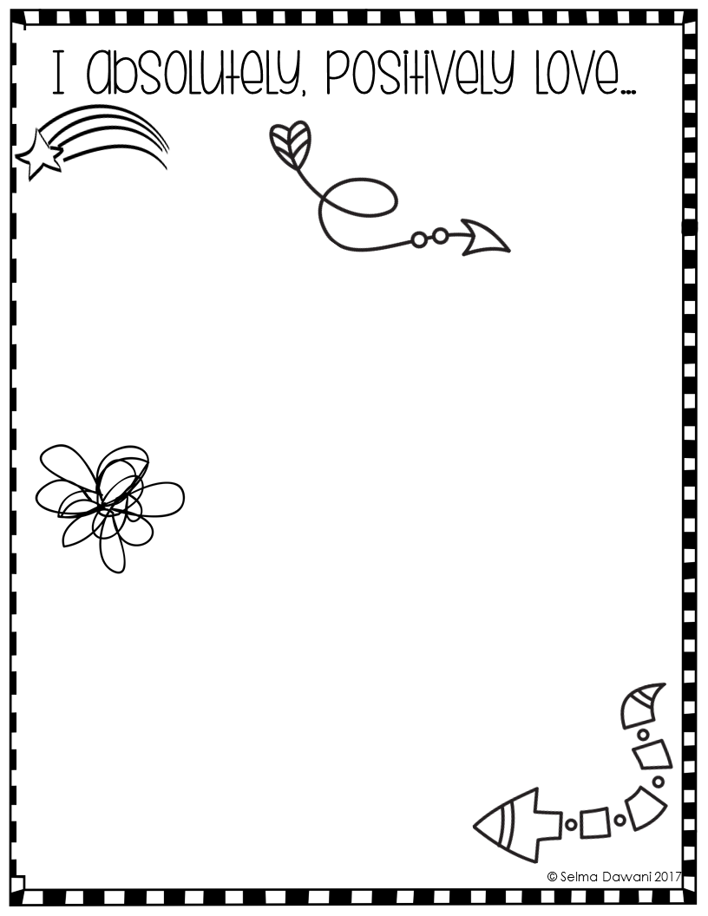
Welcome Back!!!!!
What are you passionate about?
What would you jump out of bed for early Saturday morning?
Write and doodle draw all over this page all the things that you LOVE and are PASSIONATE about.

Slide 2
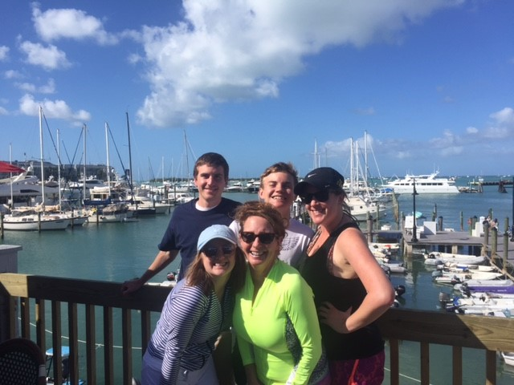
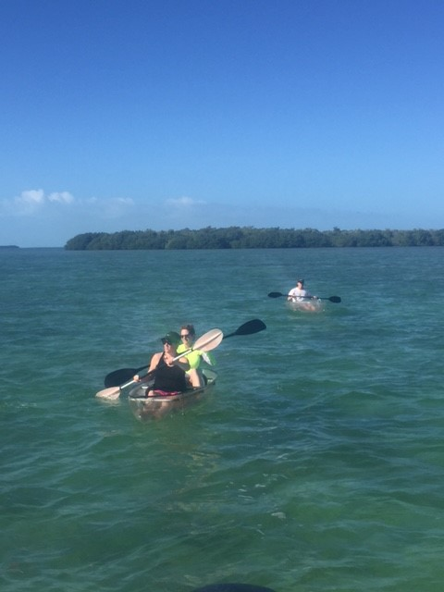
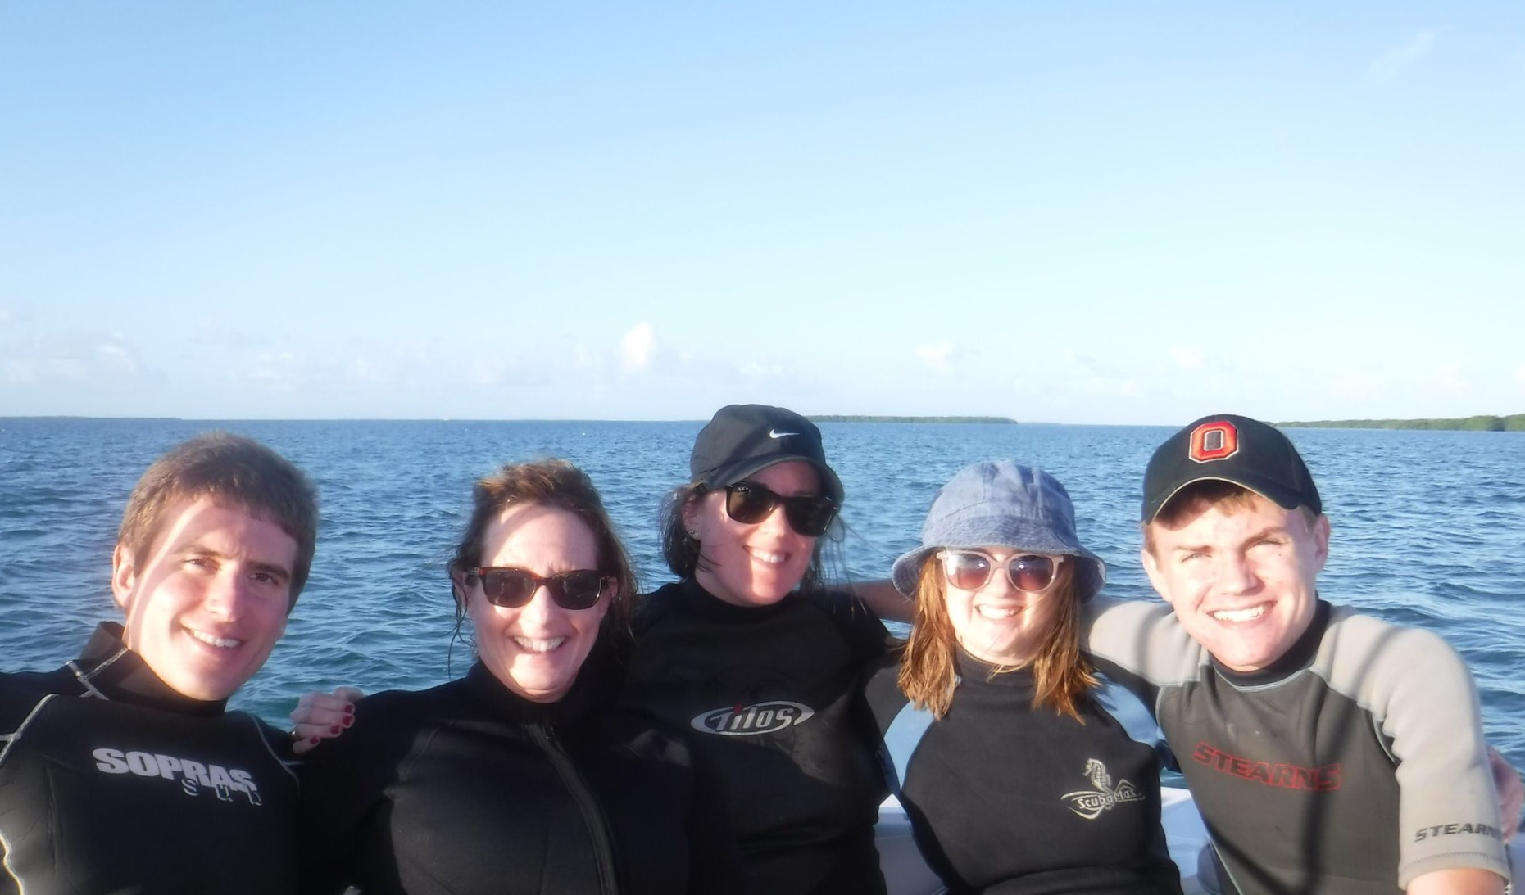
Just wanted to share a few pictures from Christmas in Key West with these goobers!!!!

Slide 3
Fronk’s Goals for this semester:
Move every student forward from where they are at…I will measure this in two ways 1. by your work/grades/classroom participation and 2. Milestones scores. You deserve to be excellent!!!
Plan for the most engaging and interesting classes as I possibly can!!! I will measure these by Fronk’s Progress Reports

Slide 4
Goal Setting Workshop
This week we will be having a goal setting workshop.
At the end of the workshop, you will have learned about S.M.A.R.T goal setting, your values, and have to actionable plans to achieve your dreams.

Slide 5
Please stand up by your desk and be ready to respond if the following statements are true for you!!!!

Slide 6
You keep a written or electronic daily agenda
of homework assignments, projects, etc.
You eat breakfast.
You get 8 hours of sleep each night and daily exercise.
You read for pleasure.
You have a personal project outside of school.
You review your notes each day.
You limit your screen and TV time.

Slide 7
DISCUSSION TIME
What do you think these statements mean?
What is the purpose they serve?
What could they help you with?
What was the purpose of this activity?

Slide 8
Who in here is a goal setter?
Have you achieved them?
Why or why not?
What process did you use to set
And achieve your goals?

Slide 9
Review of procedures for trouble spots:
1. tardiness
2. sitting in assigned seat
3. taking a seat quietly and beginning opener
4. snacking
This is tough love people!!

Slide 10
I missed you, fierce golden panthers!!!! Hope everyone had an awesome break!!!

Slide 11
Growth Mindset: https://www.youtube.com/watch?v=NG3HxrW1qZk

