Slide 1
Good morning Golden Panthers!
Please visit your locker—do not keep your backpack in this room!
Eat a good breakfast.
Remain seated and talk quietly with a friend or read!

Slide 2
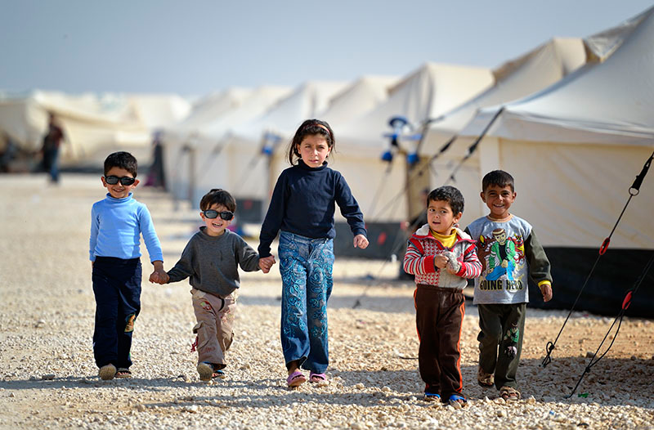
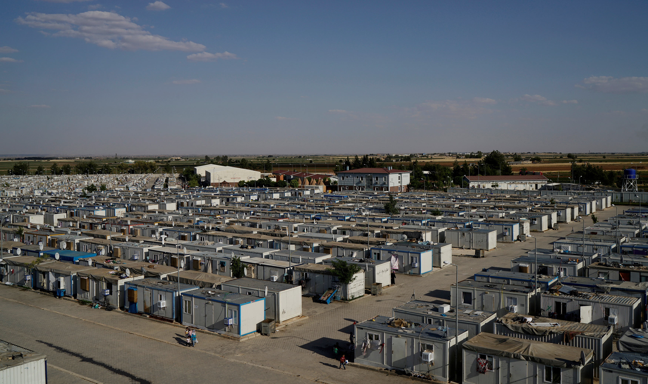
Welcome ELA!!!
Today’s opener is two short video clips about refugees.
Please make a See, Hear, Feel and Believe chart on your half sheet
https://www.youtube.com/watch?v=rIolTbJ_K5U UNHC organization
https://www.youtube.com/watch?v=2usLowIQ-VM Ben Stiller

Slide 3
Today’s Agenda:
Readers and Writers will have their separate tasks explained.
Question and Answer session.
Readers begin working.
Writers watch video on hook and thesis for intro.
Closing=Learning Take-Away

Slide 4
Sacred Last 5 Minutes:
You are seated and quiet
You are completing the learning takeaways TOD.
I’ll collecting theseC for a grade in synergy

Slide 5
Short video on writing a hook and thesis statement:
https://www.youtube.com/watch?v=F8IhjBBIMrE

Slide 6
Writers-4th period
Amiyah
Santcha
Yakira
Mope
Sebastian
Janae
Joshua
Adam
Briana
Kimberly
Zonnie
Jadyha
Reneisha
David
Kierra
Antonio
Keyara

Slide 7
Readers-4th period
Kiarra
L’Oreal
Liam
Phi
Derrick
Isaiah
Erika
Joshalynne
Dallas
Stephen

Slide 8
5th period Writers
Amy
Abby
Laila
Briana
Angel
Esveydy
D’Nasiah
Jermaine
Adaora
Kailyn
Sarai
Matthew
Mara
Jada
Alexis
Jonathan
Luis
John B.
Ana

Slide 9
5th Period Readers
David
Katie
Ricky
Endya
Nelson
Timothy
Kiara
Chanah
Isaiah
Brooke

Slide 10
6th Period-Writers
Luis
Nadia
Breyana
Naseer
Raymond
Cheuvi
Melanie
Jacueline
David
Vanessa
Nayeli
Cinthia
Ja’liaya
Andy
Jacob
Alana

Slide 11
6th period Readers
Adonis
Ratchel
Devyn
Angel
Kylan
Samuel
Yeny
Eduardo
Anthony

Slide 12
https://www.youtube.com/watch?v=qb5xHoZdmcU
Brain Break…
Watch me whip??

