Slide 1
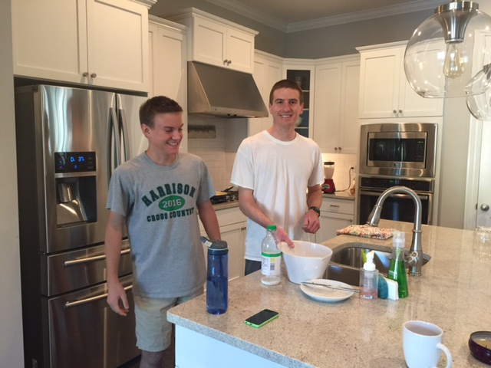
Good Morning Homeroom!!!
Please remember to be respectful, responsible and safe this morning!
Go to your locker, get some breakfast and sit quietly, please!!
My boys made a great breakfast for Mother’s Day! Scrambled eggs, blueberry muffins and smoothies.

Slide 2
Welcome ELA!!!
Please be responsible, respectful and safe!
Sit quietly and begin working on your Top 10 Opener!
My boys made a great breakfast for Mother’s Day! Scrambled eggs, blueberry muffins and smoothies.

Slide 3
This Week in ELA…
Monday (today) ------------------------------------------------→Storybook ppts are due
Tuesday -------------------------------------------------→ELA Final Exam
Wednesday ------------------------------------------------→Quarter 4 Benchmark, Mini 2
Thursday -----------------------------------------------→Finish BFG
Friday ------------------------------------------------→Quarter 4 Benchmark, Mini 3

Slide 4
This Week in AC ELA…
Monday (today) ------------------------------------------------→Twisted Fairytale folders are due
Tuesday -------------------------------------------------→ELA Final Exam
Wednesday ------------------------------------------------→Quarter 4 Benchmark, Mini 2
Thursday -----------------------------------------------→Finish BFG
Friday ------------------------------------------------→Quarter 4 Benchmark, Mini 3

Slide 5
Ducklings Doing Bombs!
Brain Break: https://www.youtube.com/watch?v=I6bl6bv333M

Slide 6
Welcome ELT!!
Today’s Agenda…
The Length of a School Year – Partner Problem
Bathroom and Locker Break
Walk to lunch outside and visit with Corvette Guys (we’ll leave a few minutes early)
Goosebumps Episode during our lunch in classroom

