Slide 1
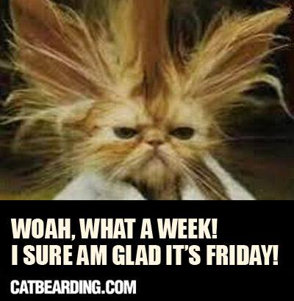
Good Morning Golden Panthers! Thank you for a wonderful week!!!
Please remember to visit your locker and eat a good breakfast!
You are the best!
<----Are you feeling it?

Slide 2
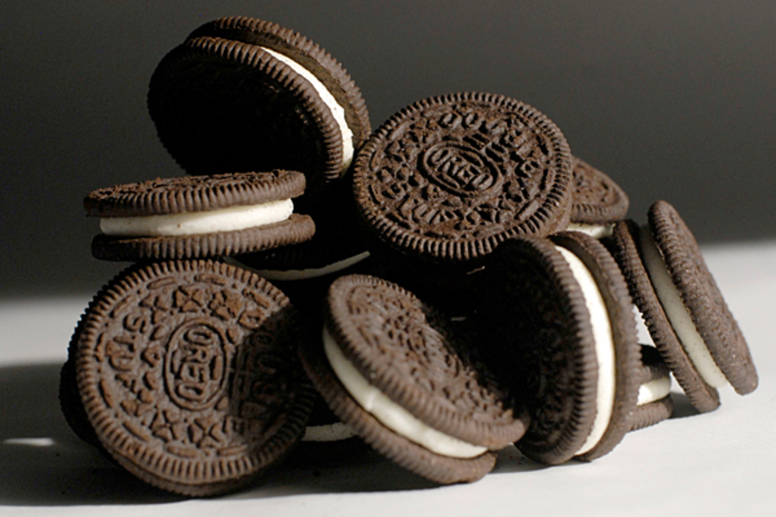
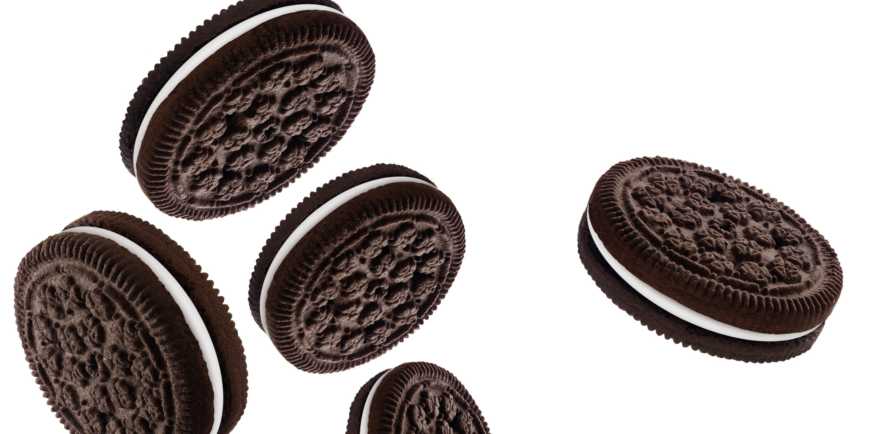
Is this a strong analogy? Why or why not?
Put your homework in the basket on the back table!!!!

Slide 3
Partner Quiz Guide:
You may only ask questions to your partner
You do not have to use your partner’s help
3. You must keep your volume at a 1 or 2
4. Do not get up and do not speak to anyone else in the room

Slide 4
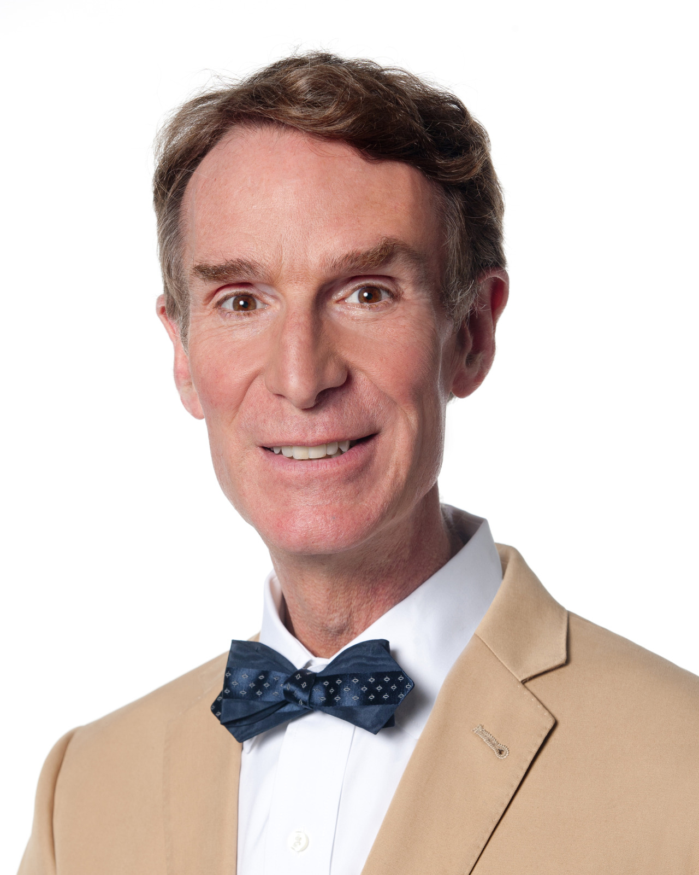
Welcome Back Golden Panthers!!!
Its Bill Nye Friday!!!!
Bill! Bill! Bill! Bill!

Slide 5
4th Period Partners:
Kimberly, Keyara
Kiarra, zonnie
Reneisha, Mope
Brianna, Amiyah
Bria, Yakira
Sebastian, Adam
Phi, Erika
Jadyha, David
Janae, Antonio
Stephen, Isaiah
Dallas, Derrick
Liam, L’oreal
Santcha, Joshalynne

Slide 6
5th Period Partners
Adaora, Elyssa
Jada, Ana
Kiana, Esveydy
Laila, Luis
Kaelyn, Endya
Ricky, Matthew
Alexis, D’Nasiah
Chanah, Samara
Sarai, Jonathan
Jason, Jermaine
Angel, Timothy
David, Brooke
Angel P, Amy
Katie, John

Slide 7
6th Period Partners
Naseer, Vanessa
Nayeli, Cheuvi
Andy, Jaliyah
Adonis, Alana
David, Melanie
Yeny, Jacob
Kylan Jacqueline
Breyana, Raymond
Luis, Eduardo
Nadia, Donovan
Angel, Sam
Devyn, Jordan
Anthony, Ratchel

