Slide 1
Good Morning Homeroom!!!!
Yup, we’re…
We’re the best HR!!
Get ready to have an awesome day!!!

Slide 2
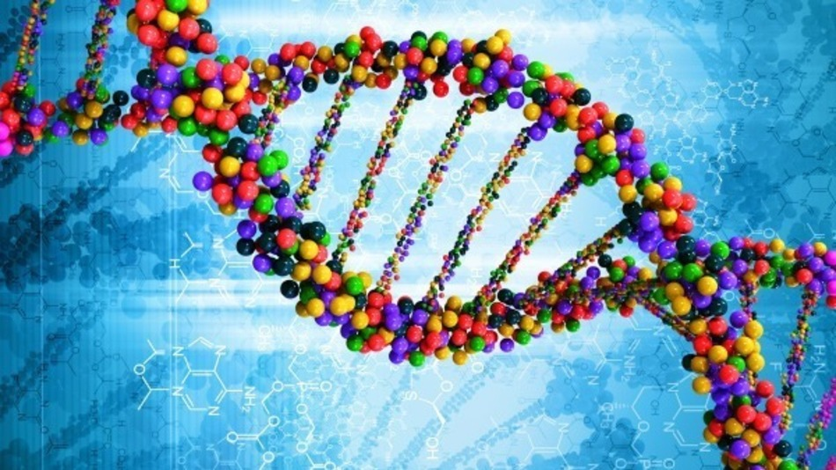
Welcome ELT!!
We’re doing the Very Berry DNA Lab today!!
We’ll be attempting to extract DNA strands from a strawberry!
Please sit in your assigned seats—you will not need your notebooks. Please clear everything from the desktops so we have space to work

Slide 3
What you need:
A strawberry
1/8 t. salt
1 c. cold H2O
2 T. detergent
Ziploc bag
1 T. rubbing alcohol
Toothpick
Decide who will do which part of the experiment in section “What to Do” on your sheet. Write the names down by each step. There are 4 steps, combine step 2 and 3

Slide 4
Step 1:
Place 1 large strawberry, 1/8 t. salt and 1 cup cold water in a Ziploc bag.
Mash the strawberry using your fingers on the outside of the Ziploc bag and then shake the bag for 3 minutes.

Slide 5
Step 2:
Pour the strawberry/salt mixture through a strainer into the clear cup.
Step 3:
Add 2 T. Detergent and mix gently. Let the solution stand for 10 mins.

Slide 6
Step 4:
Tilt the container.
Slowly pour 1 T. of chilled alcohol down the side so that it forms a layer on top of the strawberry solution.
Be careful not to mix the alcohol and strawberry solution or the DNA extraction will not work.

Slide 7
Step 5:
Let the strawberry/alcohol solution sit for a few minutes.
White, stringy, filmy stuff that looks like cotton candy will begin to appear where the strawberry solution and alcohol meet.
After 5-10 minutes, use a toothpick to collect the strands around the toothpick.

Slide 8
What happened??
Why did you have to shake the strawberry solution?
Why do you think you needed to add the soap?
What was the purpose of the cold alcohol?

