Slide 1
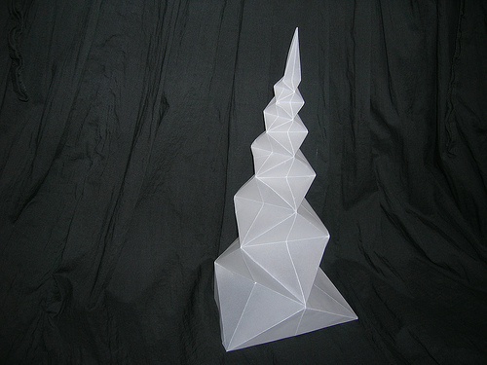
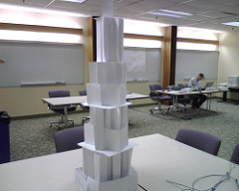
Welcome Back ELT!!!!
Please take a seat quietly and be ready to build some towers!!! Think about how you might want to design your tower—if you’re using tissue paper (very light and fragile) or cardboard (very sturdy)

Slide 2
The Paper Tower Experiment/Design Process
Build the tallest tower you can. You can bend, tear, crumple or tear the tissue paper or cardboard.
Try to make the tower taller. Keep redesigning it until you can’t go any higher.
Use the ruler to measure the height of your tower. It must stand for at least 30 seconds without falling over.

Slide 3
How can you make your tower taller? (problem)
Design Experiment:
What happens if you add 20 cm (about 8”) of tape?
What happens if you use books to support the foundation?
Choose one thing to change (that’s the variable) and make a prediction.

Slide 4
Cardboard Towers:
Andrian and Kayli
Ana and Kylan
Ajah and Macy
Angel and Jesus
Sam and David
Tissue Towers:
Elizabeth and Alona
Elyssa and Cinthia
Daniel and Jeffrey
Yeny and Yesenia
Chanyce and Maria
Jadya and Zaliyah
Matthew and Jamil
Macy and Trevon

