Slide 1
ELT Klee Quote Project

Slide 3
ELT
Reflection on Klee-Inspired Quote
Please write a reflection which includes:
Why you chose the word(s) to illustrate. What do these words mean to you?
What did you learn in the process of making the art?
What did you learn about others in the class, based on the word(s) they chose?

Slide 4
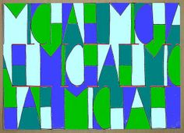
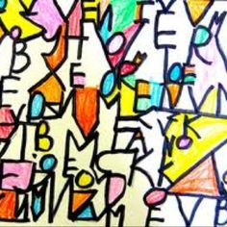
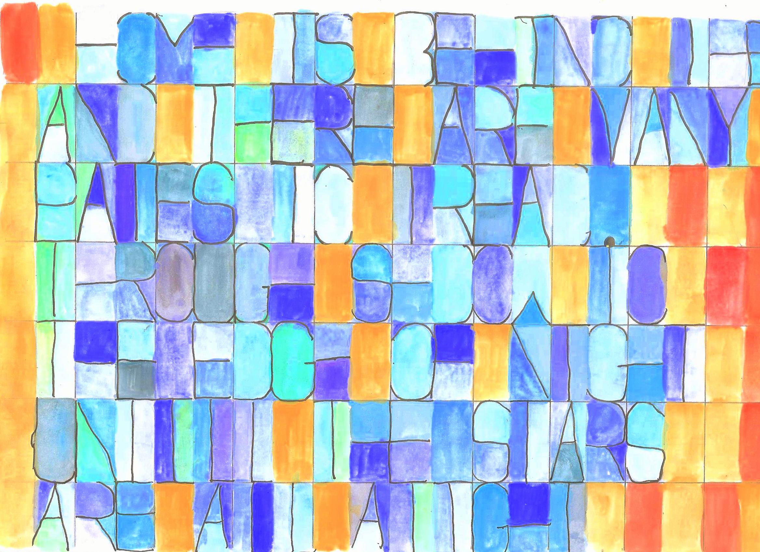
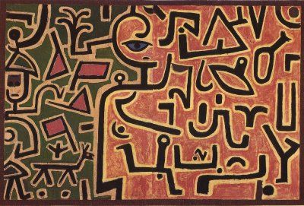

Slide 5
Directions:
First choose a word, short piece of song lyrics, name, or important phrase
2.Count the letters and spaces
3.Mark the lines on your paper to match the number of letters and spaces you need
4.Draw in the letters to fit the size of each section your lines have marked

Slide 6
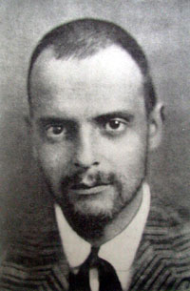
Paul Klee was a Swiss and German artist best known for his large body of work, influenced by cubism, expressionism and surrealism.
“A line is a dot that went for a walk.”
—Paul Klee

